Slide 1
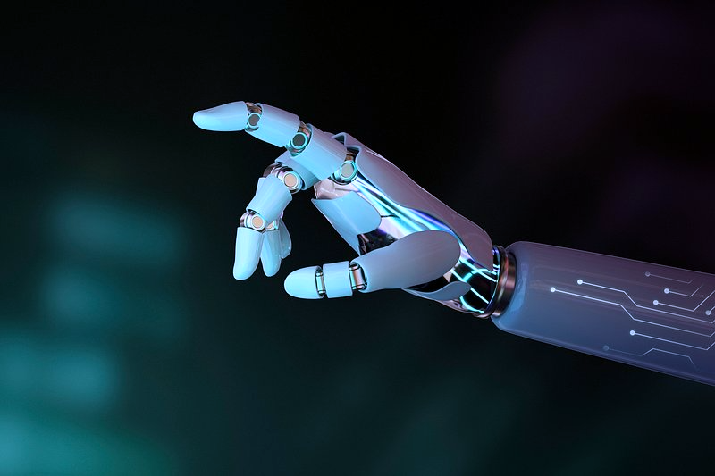
Sign Language To Text
Oren Raz and Lam Kai Yi Karen

Slide 2


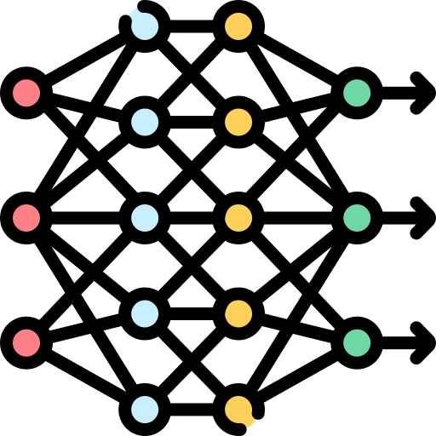
Our vision
AIM: Translate Word Level Sign Language to Text
Simple-to-Use Web Application and APP
A convenient and fuss-free user interface to enable users to access the model at their own time
How?
High Accuracy, High Speed Translation Model
A Machine Learning model with the ability to translate video inputs of signed words into English instantaneously and with high accuracy
The Goal
Bridge the communication gap between people with hearing impairment and people with no/little knowledge in sign language

Slide 3

The DEMO

Slide 4
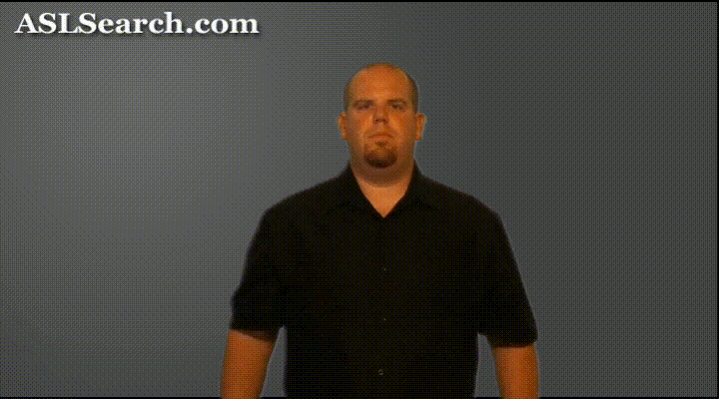
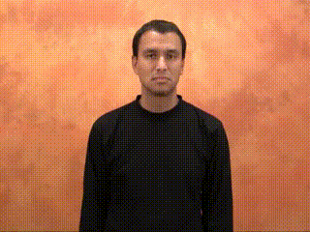
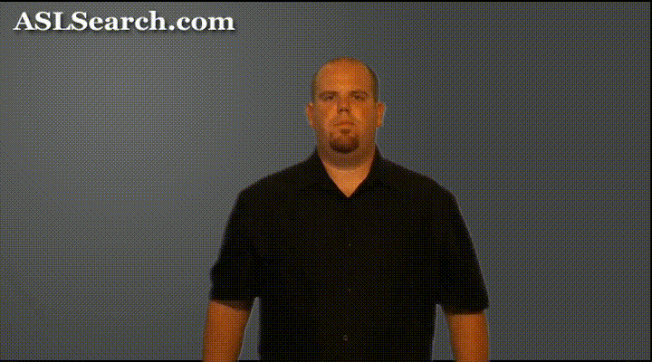
Challenges we faced
#1 Unclean Data: Some words can be signed in multiple ways to convey slightly different meanings.
#2 Landmark strategy: Challenges with Mediapipe library, slow without GPU, does not work on Mac unless in Docker.
#3 Frontend and Backend linkage.
Word = "short"

Slide 5
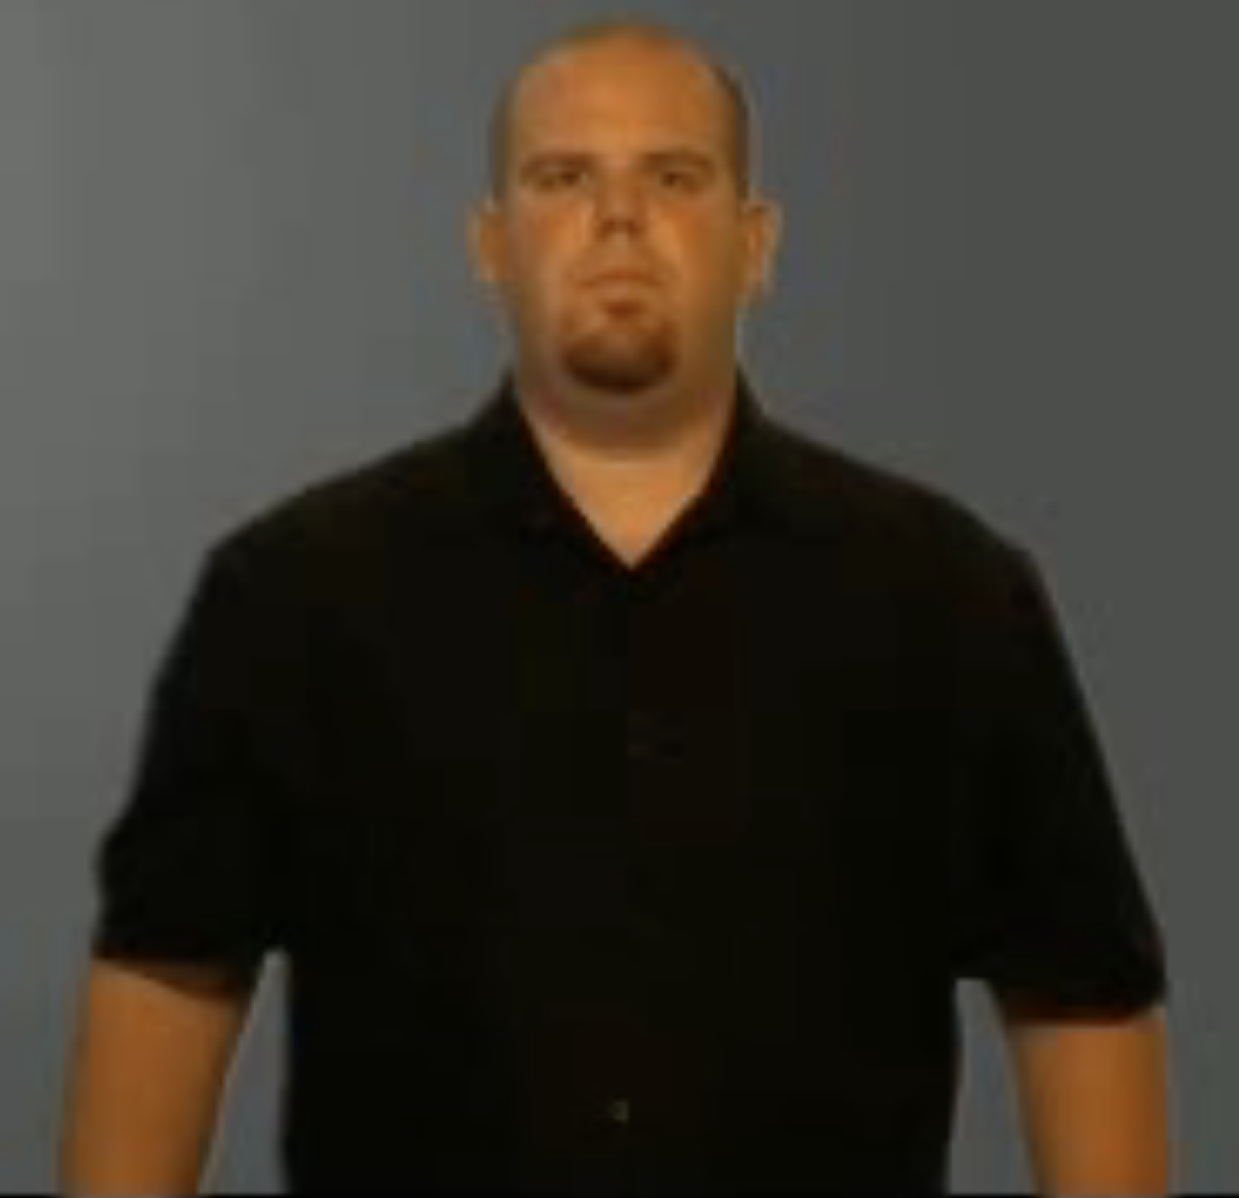
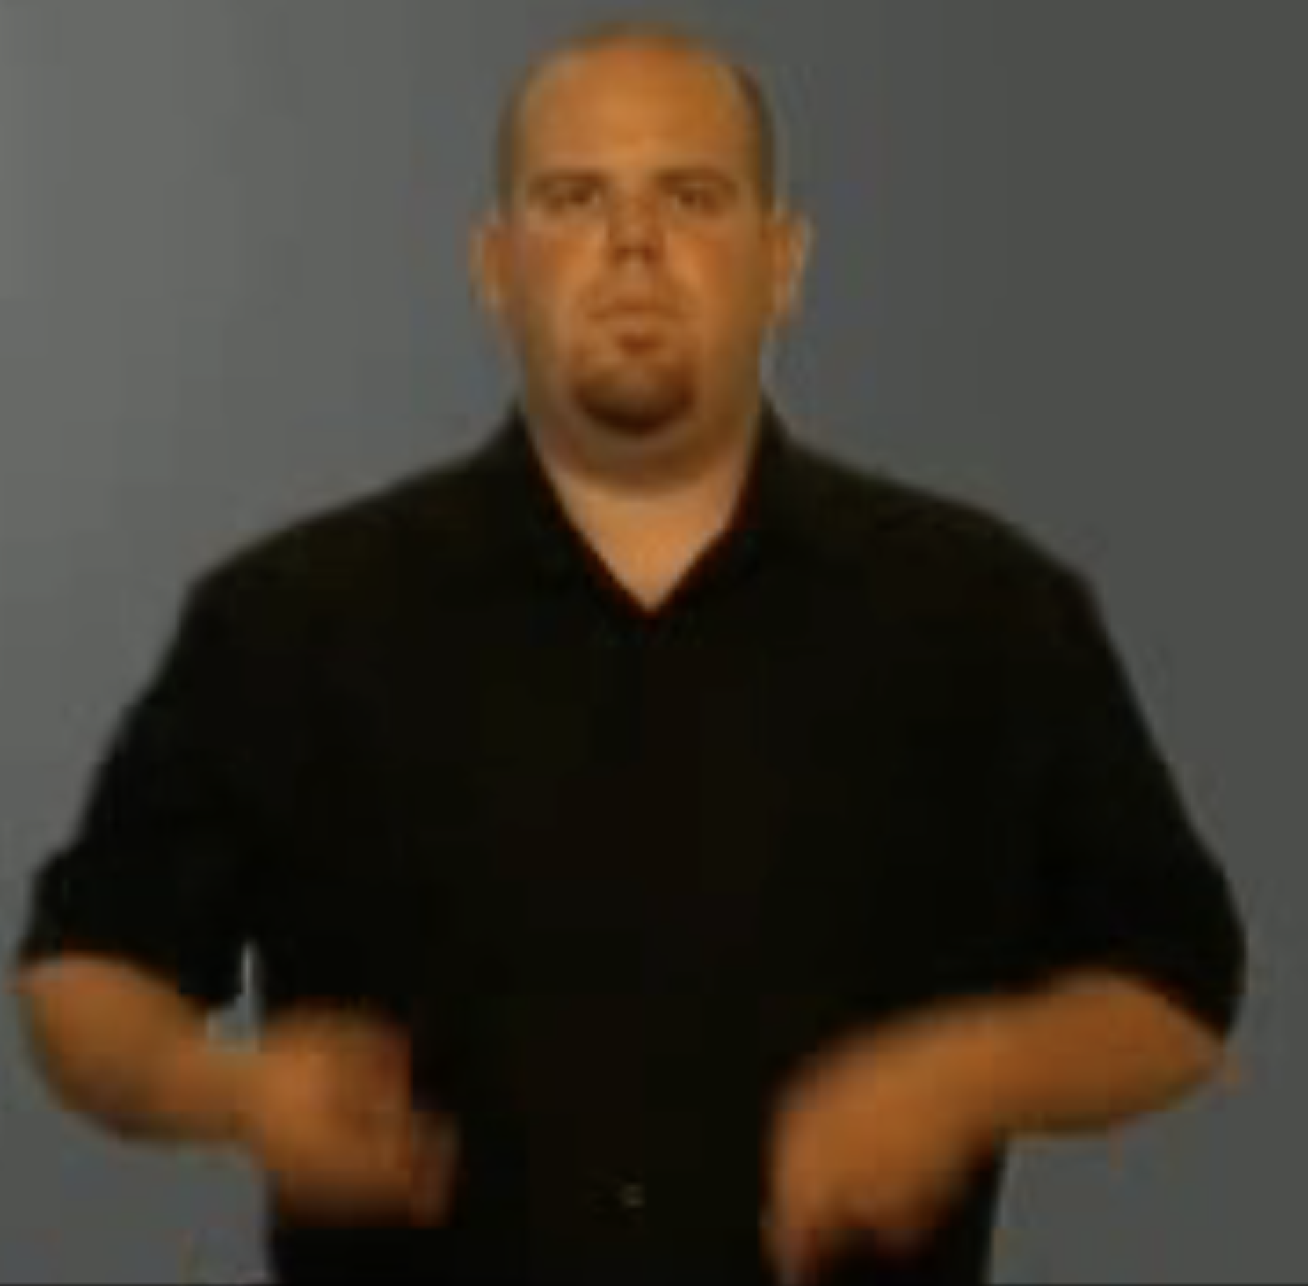
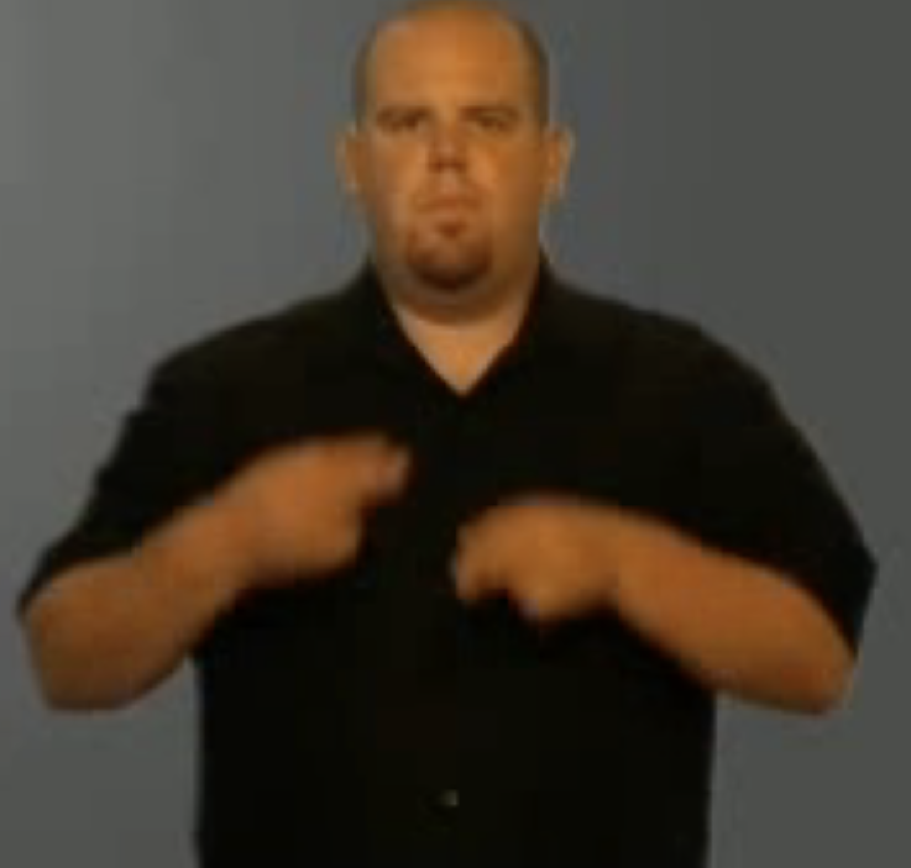
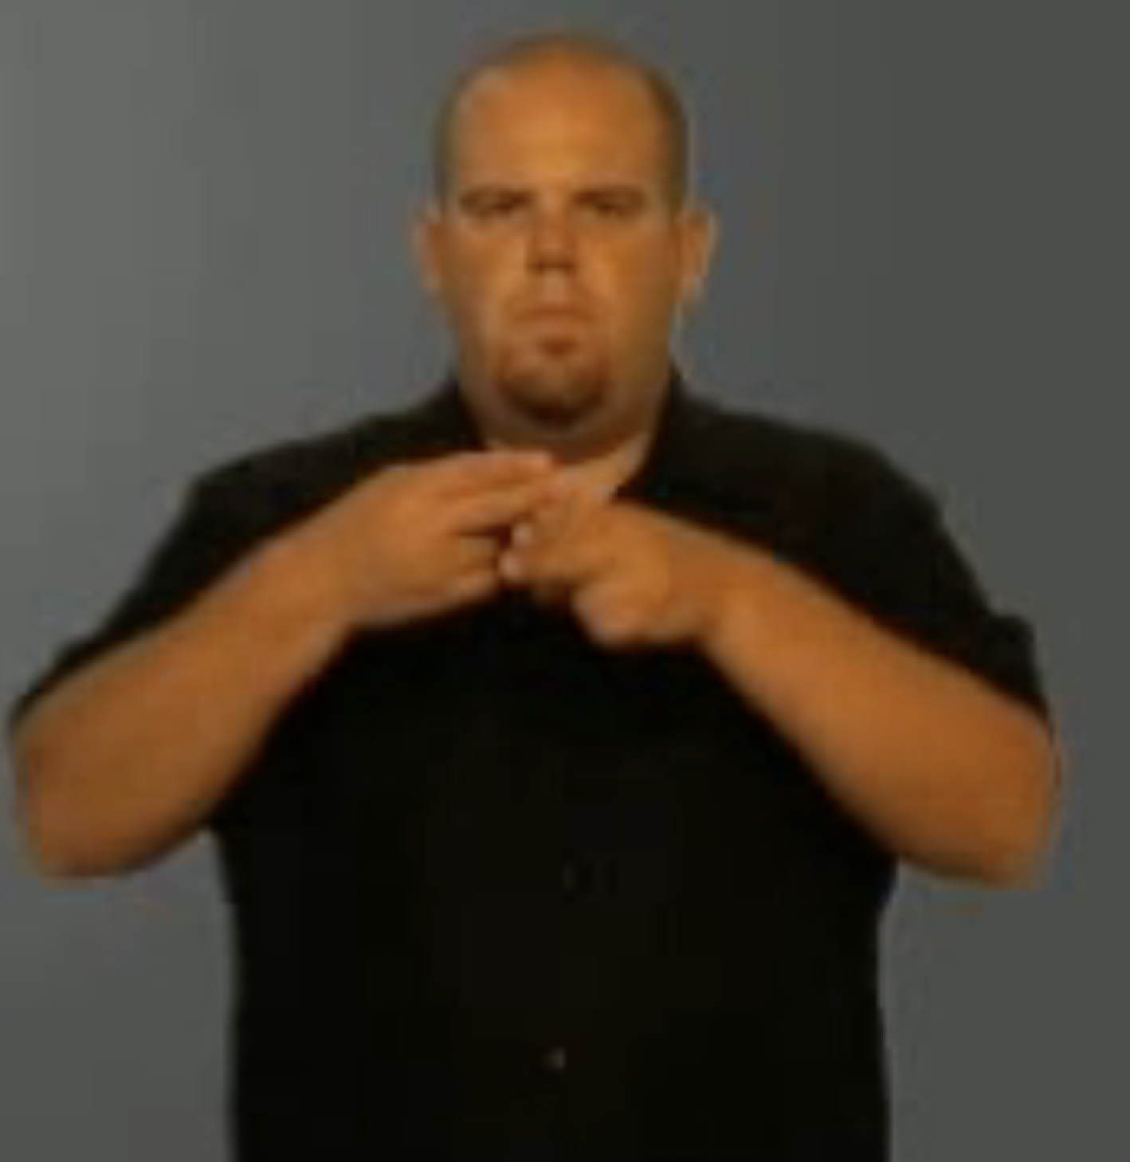
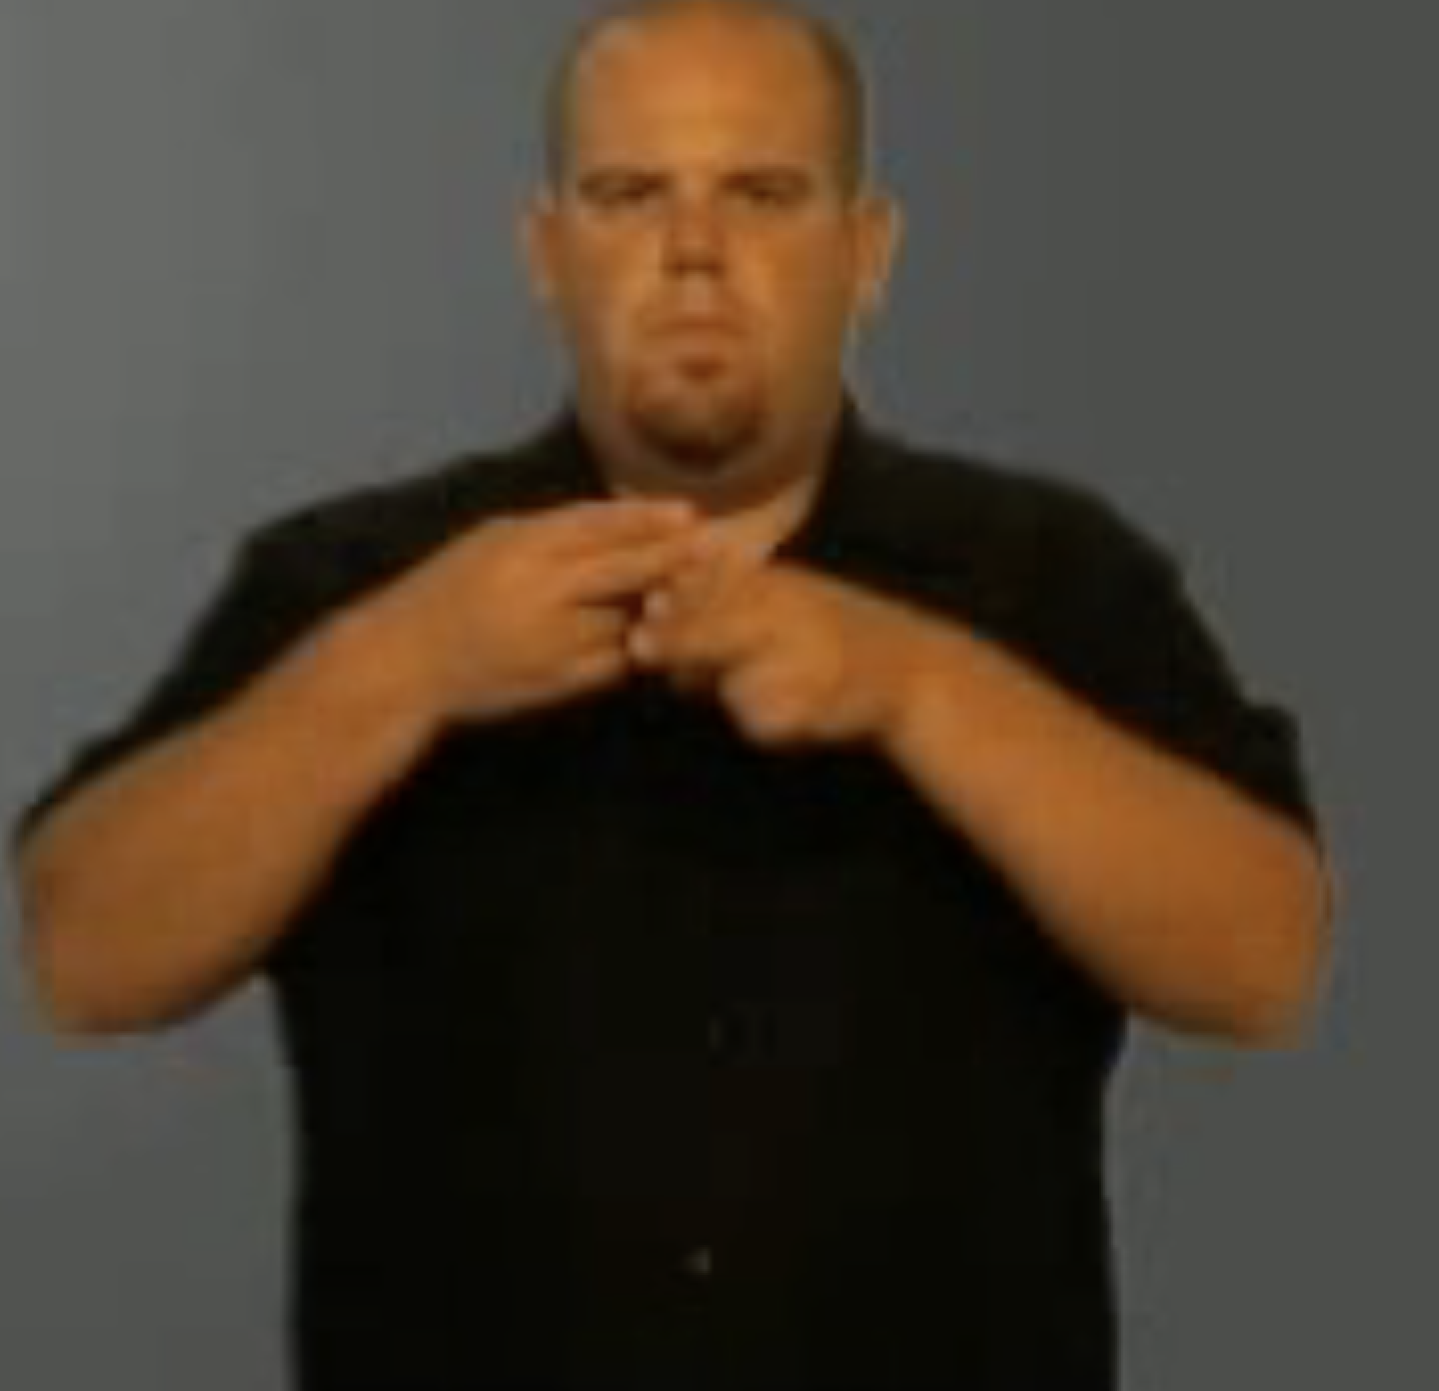
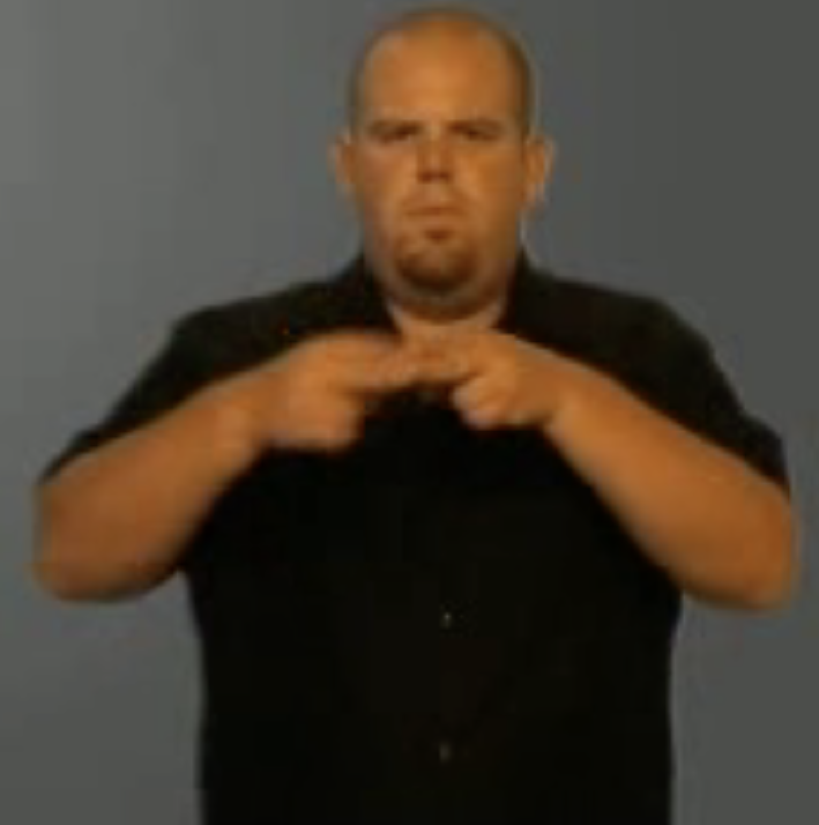
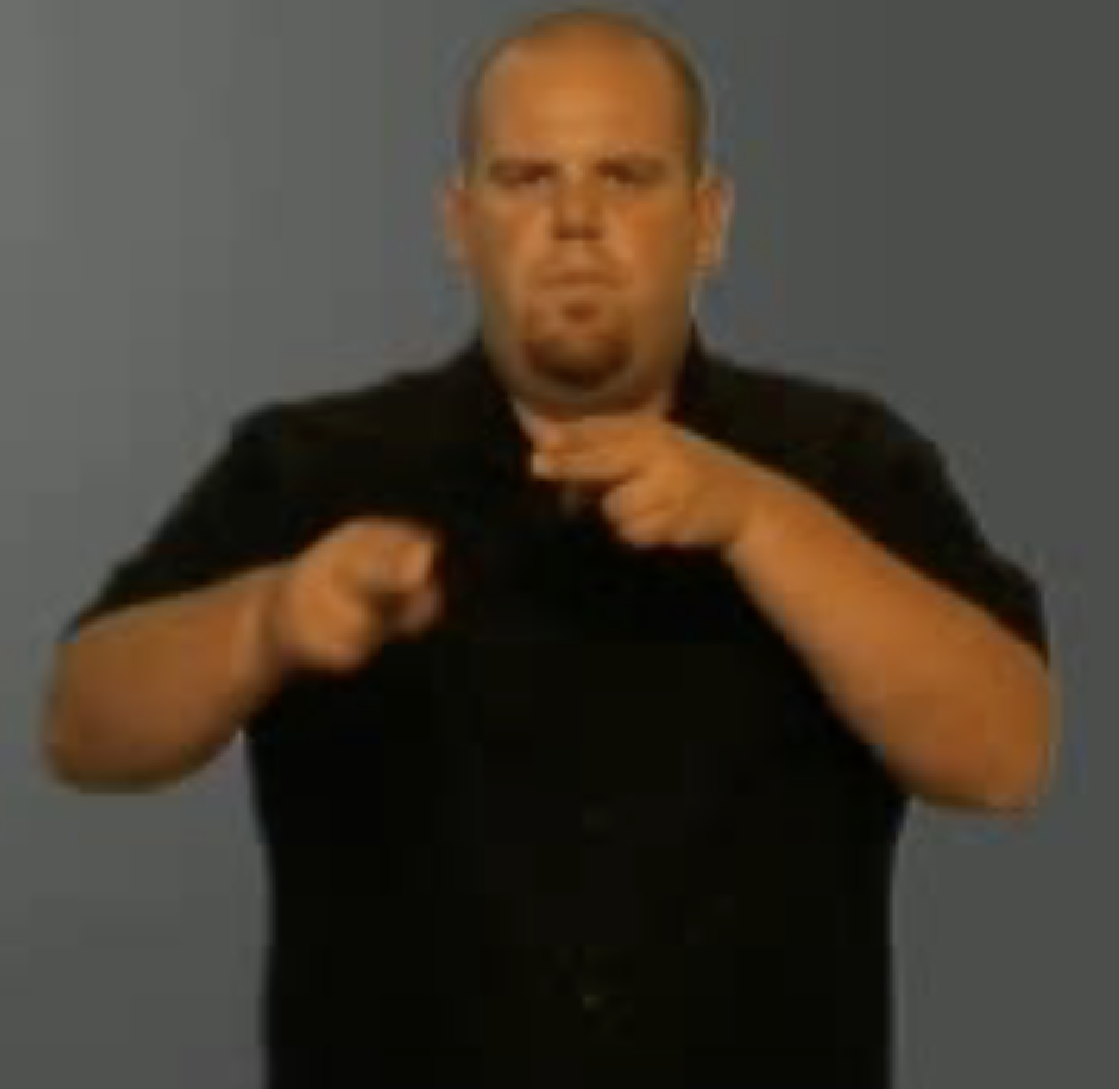
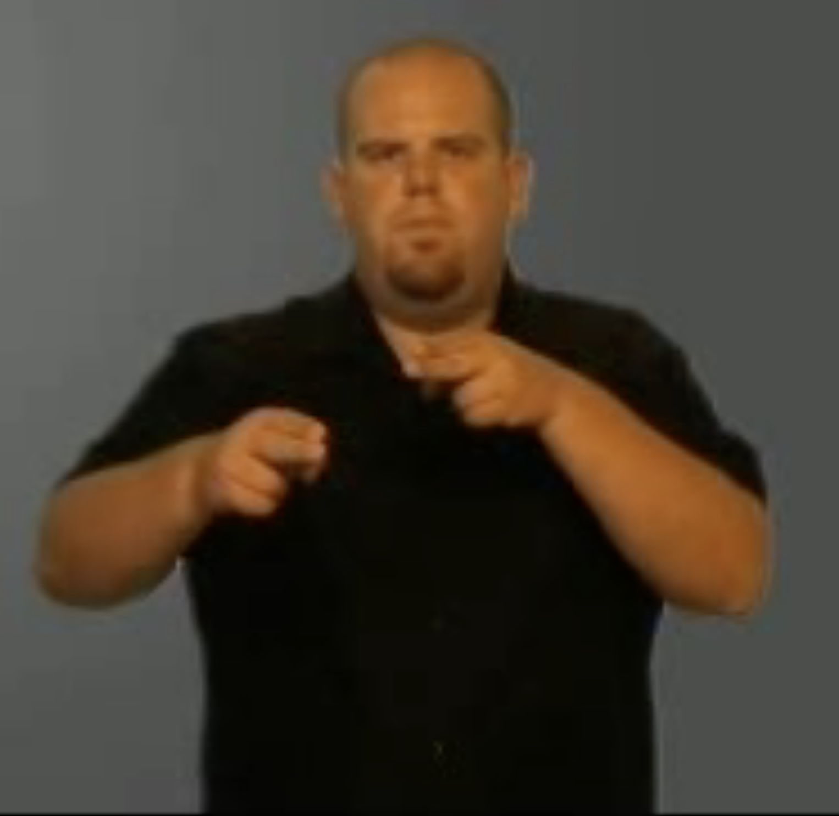
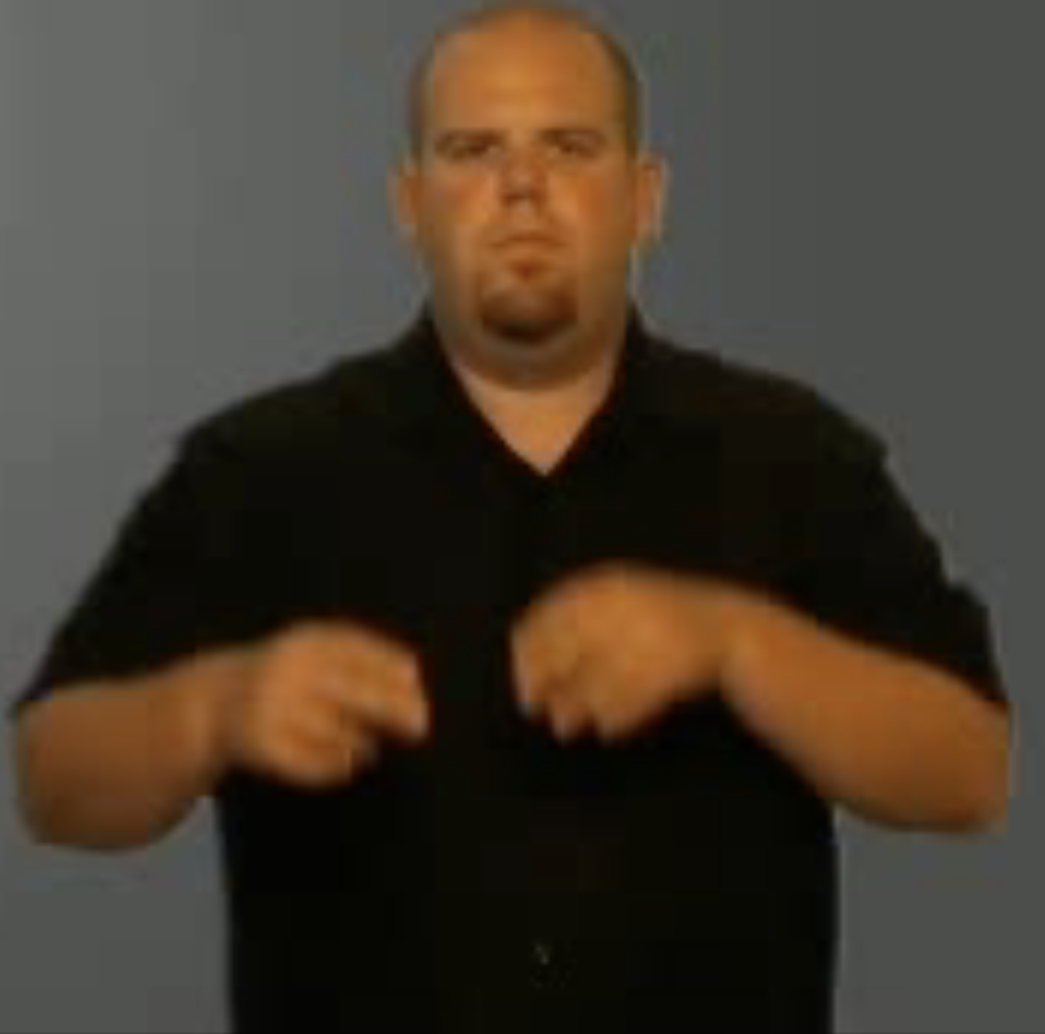
Future Work Idea #1
#1 Exploration of other model implementations – SigLIP and another one (next slide).
#2 Data collection for Icelandic sign language in collaboration with the Icelandic deaf association (applied for Rannís grant for that purpose).
#3 Build a real application.
SigLIP + Regression Model
Select 9 frames
Output

Slide 6
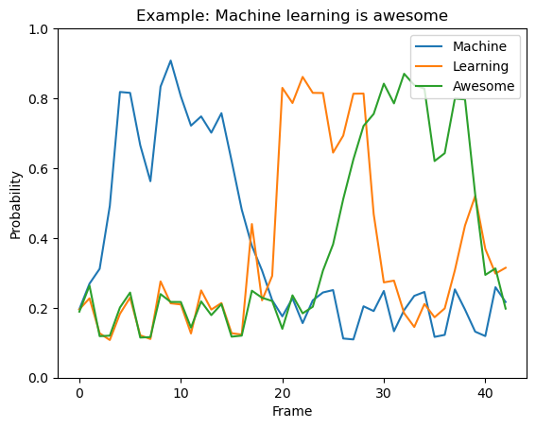
Future Work Idea #2
Model architecture:
CNN analyze each frame individually.
Assigns probability per word per frame.
Analyze results, ensure to clean noise.
Advantages (our hypothesis):
Can be faster, perhaps even fast enough to work on phones.
Accuracy-speed tradeoff, may decrease frame rate for low hardware device.
Accepts infinite video length with live output prediction, 1-2 sec delay.

